Slide 1
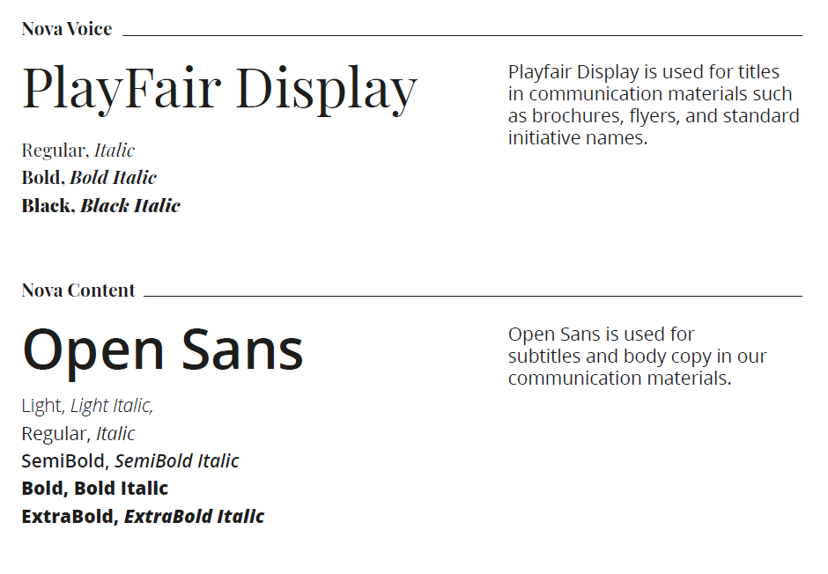
NOVA SBE TEMPLATES
Guidelines
Before using this template, please make sure you have all the fonts installed.
You will need Playfair display and open sans.

Slide 14


